Slide 1
Evolutionary Computing
Chapter 5:
Fitness, Selection, and Population Management

Slide 2
Fitness, Selection, Population Management
Selection is one of the two fundamental forces in evolutionary systems
Selection increases quality, decreases diversity
Related machinery in EC contains:
Population management models
Selection operators
Diversity preserving tricks

Slide 3
Population Management
Two different population management models exist:
Generational model
each individual survives for exactly one generation
the entire set of parents is replaced by the offspring
Steady-state model
a few new individuals (children) are generated per generation
a few old members of the population are replaced
Generation Gap
The proportion of the population replaced
Parameter, value
= 1.0 means Generational EA,
< 1.0 means Steady State EA
Q: Can someone survive?
menti.com

Slide 4
Fitness based competition
Selection can occur at two places:
individuals from current generation to take part in mating (parent selection)
individuals from parents + offspring to go into next generation (survivor selection)
Selection operators work on whole individuals, hence they are representation-independent
Distinction between selection
Operators: define selection probabilities
Algorithms: define how probabilities are implemented
This distinction is often forgotten or deemed irrelevant

Slide 5
Fitness-Proportionate Selection (FPS)
Probability for individual i to be selected for mating in a population of size μ with FPS is
This method has problems including:
Premature Convergence: One highly fit member can rapidly take over, if the rest of the population is much less fit and population members become (nearly) identical. When this happens too early, we can end up in a local optimum.
Loss of selection pressure: At the end of runs when fitness values are similar, EA can degrade to random search
Highly sensitive to function transposition

Slide 6
FPS and function transposition
individual | Fitness for f | Sel. Prob. for f | Fitness for f+10 | Sel. Prob. for f + 10 | Fitness for f+100 | Sel. Prob. for f + 100
A | 1 | 0.1 | 11 | 0.275 | 101 | 0.326
B | 4 | 0.4 | 14 | 0.35 | 104 | 0.335
C | 5 | 0.5 | 15 | 0.375 | 105 | 0.339
SUM | 10 | 1 | 40 | 1 | 310 | 1

Slide 7
Parent Selection: Scaling
Windowing:
where β is worst fitness in the last n generations (n=0 → in this generation)
Sigma Scaling:
= avg. fitness in the population, = st. dev. of fitness, c is a constant, usually 2
Tries to “flatten” selection pressure over the course of evolution
Q: Which problem (1, 2, or 3)
can windowing fix?

Slide 8
Rank-based Selection
Attempt to remove problems of FPS by basing selection probabilities on relative rather than absolute fitness
Idea: rank population according to fitness and base selection probabilities on rank
This imposes a sorting overhead on the algorithm, but this is usually negligible compared to the fitness evaluation time
Population size = | μ
Rank of best | μ - 1
…
Rank of worst | 0

Slide 9
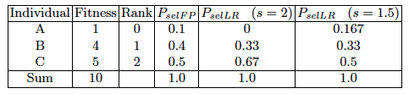
Rank-based Selection: Linear Ranking
Parameterised by factor s: 1 < s ≤ 2
s measures advantage of best individual
Simple 3 member example
Check s =1 and s = 2
w/ the hand. P(best) = ?

Slide 10
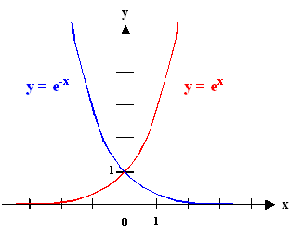
Rank-based selection: Exponential Ranking
Check for μ=10 with i=0 and i=9
Linear Ranking is limited in selection pressure
Exponential Ranking can allocate more than 2 copies to fittest individual
Normalise constant factor c according to population size

Slide 11
Sampling algorithms
Roulette wheel alg.
Stochastic universal sampling alg.
A
A
F
F
B
B
E
E
C
C
D
D
6 x
1 x
Sampling mating pool from the selection probability distribution

Slide 12
Tournament Selection (1/2)
All methods above rely on global population statistics
Could be a bottleneck especially on structured or very large populations
Relies on external fitness function which might not exist: e.g., evolving game playing strategies
Idea for using only local fitness information:
Pick k members at random then select the best of these
Repeat to select more individuals
Q: (How) would this work when
evolving game playing strategies?

Slide 13
Tournament Selection (2/2)
Probability of selecting individual i will depend on:
Rank of i
Size of sample k
higher k increases selection pressure
Whether contestants are picked with replacement
Picking without replacement increases selection pressure
Whether fittest contestant always wins (deterministic) or this happens with probability p
Q: What if k = μ ?

Slide 14
Parent Selection: Uniform
Parents are selected by uniform random distribution whenever an operator needs one (some) individual(s)
Uniform parent selection is unbiased - every individual has the same probability to be selected
When working with extremely large populations, over-selection can be used

Slide 15
Survivor Selection
Select μ individuals to form the next generation from μ parents and λ offspring
Parent selection mechanisms can also be used for selecting survivors
Survivor selection can be divided into two approaches:
Fitness-based selection
Age-based selection
Fitness is not taken into account
In SSEA this can be implemented as “delete-random” (not recommended) or as first-in-first-out (a.k.a. delete-oldest)

Slide 16
Fitness-based survivor selection
Elitism
Always keep at least one copy of the fittest solution so far
Widely used in both population models (generational, steady-state)
Can keep more than one “champion”, e.g., the best N individuals or the best x %
Delete worst (a.k.a. GENITOR for historical reasons)
From Whitley’s original Steady-State algorithm (he also used linear ranking for parent selection)
Rapid takeover: use with large populations or “no duplicates” policy
Round-robin tournament
P is the set of μ parents, O is the set of λ offspring
Pairwise competitions in round-robin format:
Each solution x from P ∪ O is compared with q other randomly chosen solutions
For each comparison, a "win" is assigned to x if it is better than its opponent
The μ solutions with the greatest number of wins are selected to be parents of the next generation
Parameter q allows tuning selection pressure
Typically q = 10
Q: how does this compare to k-tournament selection?
menti.com

Slide 17
Fitness-based survivor selection
(μ,λ)-selection a.k.a. “comma strategy”
based on the set of children only (λ > μ)
choose best μ out of λ
(μ+λ)-selection a.k.a. “plus strategy”
based on the set of parents and children
choose best μ out of μ+λ
Often (μ,λ)-selection is preferred because it can forget and hence
it is better in leaving local optima
it is better in following moving optima
using the + strategy bad σ values can survive in ⟨x,σ⟩ too long if their host x is very fit
λ ≈ 7 • μ is a traditionally good setting (but λ ≈ 3 • μ seems more popular lately)

Slide 18
Selection Pressure
Takeover time τ* is a measure to quantify the selection pressure
It is the number of generations it takes until the application of selection completely fills the population with copies of the best individual
Goldberg and Deb showed (for evolution strategies):
Specific values for
an evolution strategy with μ = 15 and λ = 100: τ* ≈ 2
a GA with and proportional selection: τ^{* =} 460
Q: which one is more “aggressive”?

Slide 19
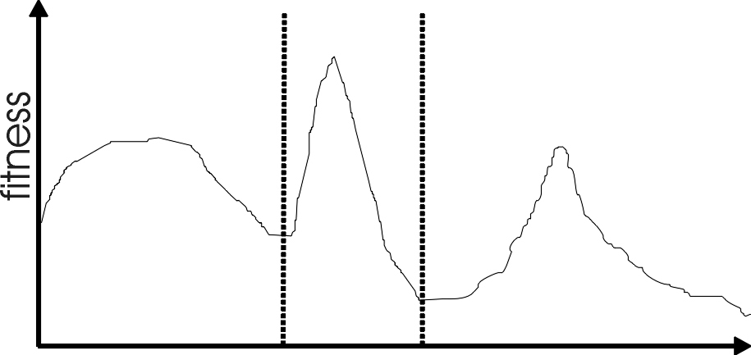
Multimodality
Most interesting problems have more than one locally optimal solution.
Notes:
There are three local optima in this landscape with different sizes basins of attraction. The global optimum is in the middle, and the leftmost local optimum has a broader peak than the rightmost, despite having a smaller basin of attraction.

Slide 20
Multimodality: Genetic Drift
Finite population with global mixing (e.g., panmictic system, where everybody can mate with everybody) implies that population eventually converges around one optimum
But we often might want to identify several possible peaks
Sub-optimum can be more attractive, e.g., if more stable or easier to make / manufacture
Notes:
Might want to identify several peaks e.g. for design example where you might want solution from a broad peak as it may be more stable to minor perturbations

Slide 21
Approaches for Preserving Diversity
Explicit vs implicit
Explicit approaches
Make similar individuals compete for resources (e.g., resource is fitness, fight for better fitness)
Make similar individuals compete with each other for survival
Implicit approaches:
Impose an equivalent of geographical separation
Impose an equivalent of speciation

Slide 22
Explicit Approaches for Preserving Diversity: Fitness Sharing
Restricts the number of individuals within a given niche by “sharing” their fitness, so as to allocate individuals to niches in proportion to the niche fitness, meaning
High fitness region: many individuals, low fitness region: few individuals
Need to set the “geometrical” size of the niche σ_{share} by distance in either genotype or phenotype space (thus: σ_{share} is NOT the nr of individuals in that niche)
Run EA as normal but after each generation set f(i) to f’(i)

Slide 23
Explicit Approaches for Preserving Diversity: Fitness Sharing
Note: if we used sh(d) = 1 instead of sh(d) = 1 – d/σ then the sum that reduces the fitness would simply count the number of neighbours, i.e., individuals closer than σ (a.k.a. σ_{share})
This creates an advantage of being alone in the neighbourhood
Using 1 – d/ σ_{share} instead of 1 implies that we count distant neighbours less than close neighbours

Slide 24
Fitness Sharing example
Let σ=3 and
f(2)=2
f(3)=2,5
f(4)=3
f(10)=4
f(12)=5
x
Indiv. 2 has 2 neighbours
Indiv. 10 has 1 neighbour
x
x
x
x
f’(2) = 2/(1+1/3+2/3)=1
f’(10) = 4/(1+1/3)=3
2
3
4
10
12
10 is twice as good as 2
10 is three times as good as 2

Slide 25
Explicit Approaches for Preserving Diversity: Crowding
Attempts to distribute individuals evenly amongst niches
relies on the assumption that offspring will be close to parents
uses a distance metric in either phenotype or genotype space
take 2 parents and their 2 offspring
set up parent vs. child tournaments such that the inter-tournament distances are minimal, that is, number the two p’s (parents )and the two o’s (offspring) such that
d(p₁,o₁) + d(p₂,o₂) < d(p₁,o₂) + d(p₂,o₁)
and let o₁ compete with p₁ and o₂ compete with p₂

Slide 26
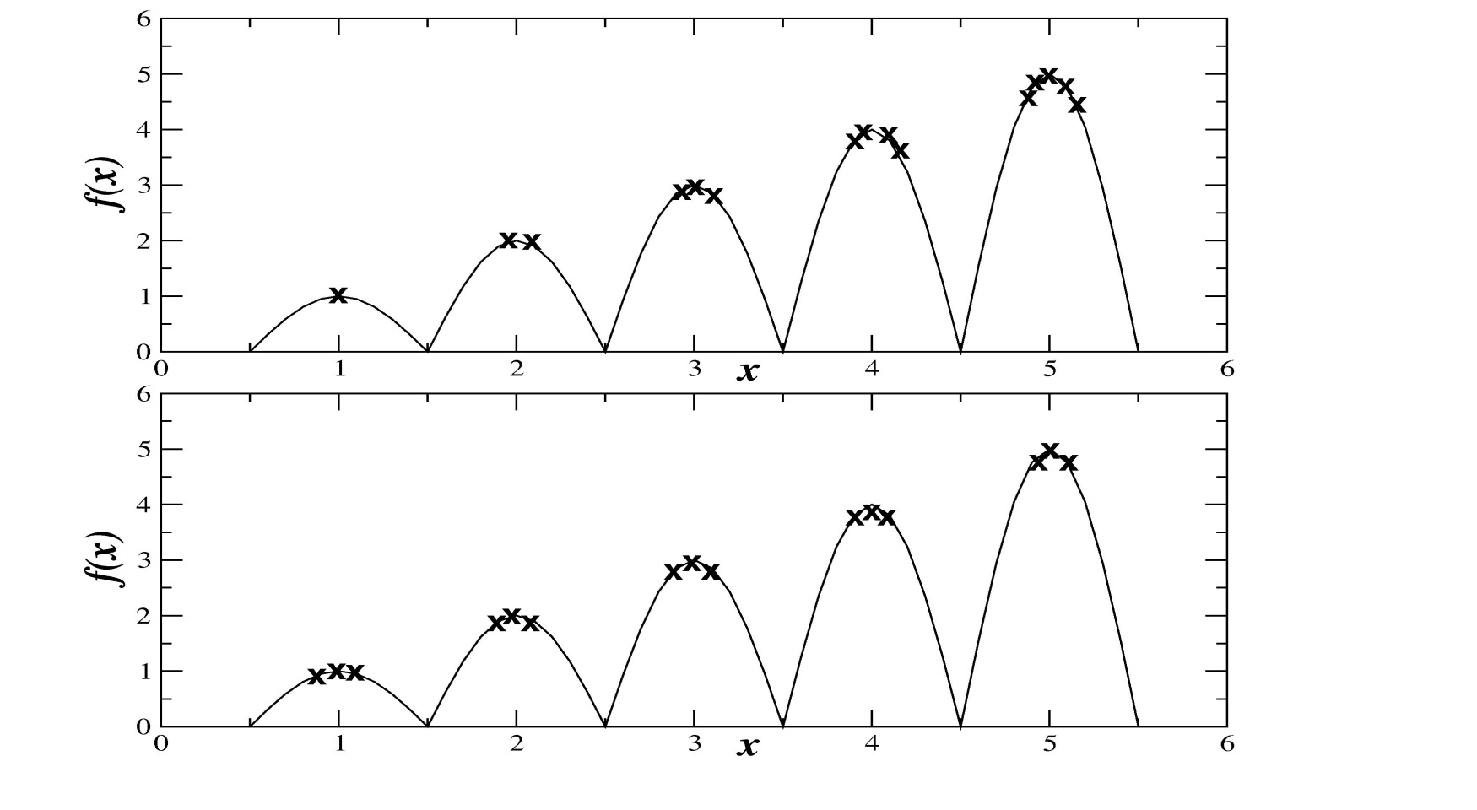
Crowding vs. Fitness sharing
Observe the number of individuals per niche
Fitness sharing
Crowding

Slide 27
Implicit Approaches for Preserving Diversity: Automatic Speciation
Restrict mating to genotypically / phenotypically similar individuals
or
Restrict mating to individuals that have the same (or very similar) tag, where
A tag is an extra bit (or bits) in the genotype that
is initialized randomly and
is subject to recombination and mutation
Q: what is a species in biology?

Slide 28
Implicit Approaches for Preserving Diversity: Island Model Parallel EAs
EA
EA
EA
Periodic migration of individuals
between subpopulations
EA
EA
Run multiple populations in parallel
After a (usually fixed) number of generations –called an epoch– exchange individuals with neighbours
Repeat until stopping criteria met
Partially inspired by parallel/clustered systems

Slide 29
Island Model: Parameters
How often to exchange individuals ?
too quick and all sub-populations converge to same solution
too slow and waste time
most authors use a range of 25-150 generations
can do it adaptively (stop each pop when no improvement for X generations)
How many individuals, which individuals to exchange ?
usually ~2-5, but depends on population size
Copied vs. moved
Some results show that
better to exchange randomly selected individuals than best individuals
“multi-culti” is even better (exchange most different ones)
Variation operators can differ per sub-population / island

Slide 30
Implicit Approaches for Preserving Diversity: Cellular EAs
Current
individual
Neighbours
Consider each individual to exist on a point on a grid (usually a rectangular toroid)
Selection (hence recombination) and replacement happen using concept of a neighbourhood a.k.a. deme
Leads to different parts of grid searching different parts of space, good solutions diffuse across grid over a number of generations

Slide 31
Implicit Approaches for Preserving Diversity: Cellular EAs
Equivalent of 1 generation is:
pick individual in pop at random
pick one of its neighbours using roulette wheel (or some other method)
apply crossover to produce 1 child, mutate the child to get final offspring
replace individual if offspring is fitter
circle through population until done

Slide 32
Different spaces
Genotype space (always)
Set of representable solutions
Phenotype space (always; it may be = genotype space)
The object coded by the genotype
Neighbourhood structure may bear little relation with genotype space
Fitness space (if quantifiable fitness is given)
The space of fitness values: (multi-dimensional) real numbers
Algorithmic space (if a spatially structured EA is used)
The structure of the population
Akin to the geographical space on which life on earth has evolved
Distance in these spaces may (and will) differ
Q: Which of these distances exist in cellular EAs?

Slide 33
Important points
Selection increases quality, decreases diversity
Selection can occur at two places in the evolutionary loop
parent selection
survivor selection
Most selection operators can be used for both purposes
Selection pressure is an important feature of EAs
Strong selection → (too) fast convergence, possibly local optimum
Weak selection → slow progress, almost random walk
Keeping up diversity is important
There are specific mechanisms for this in EAs

